Slide 1
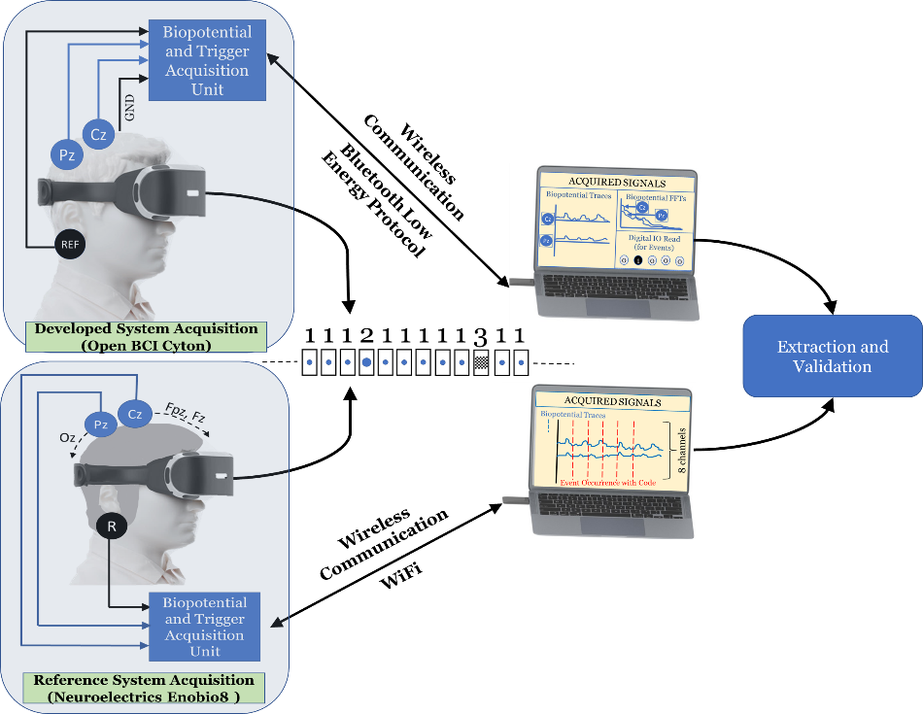

Slide 2
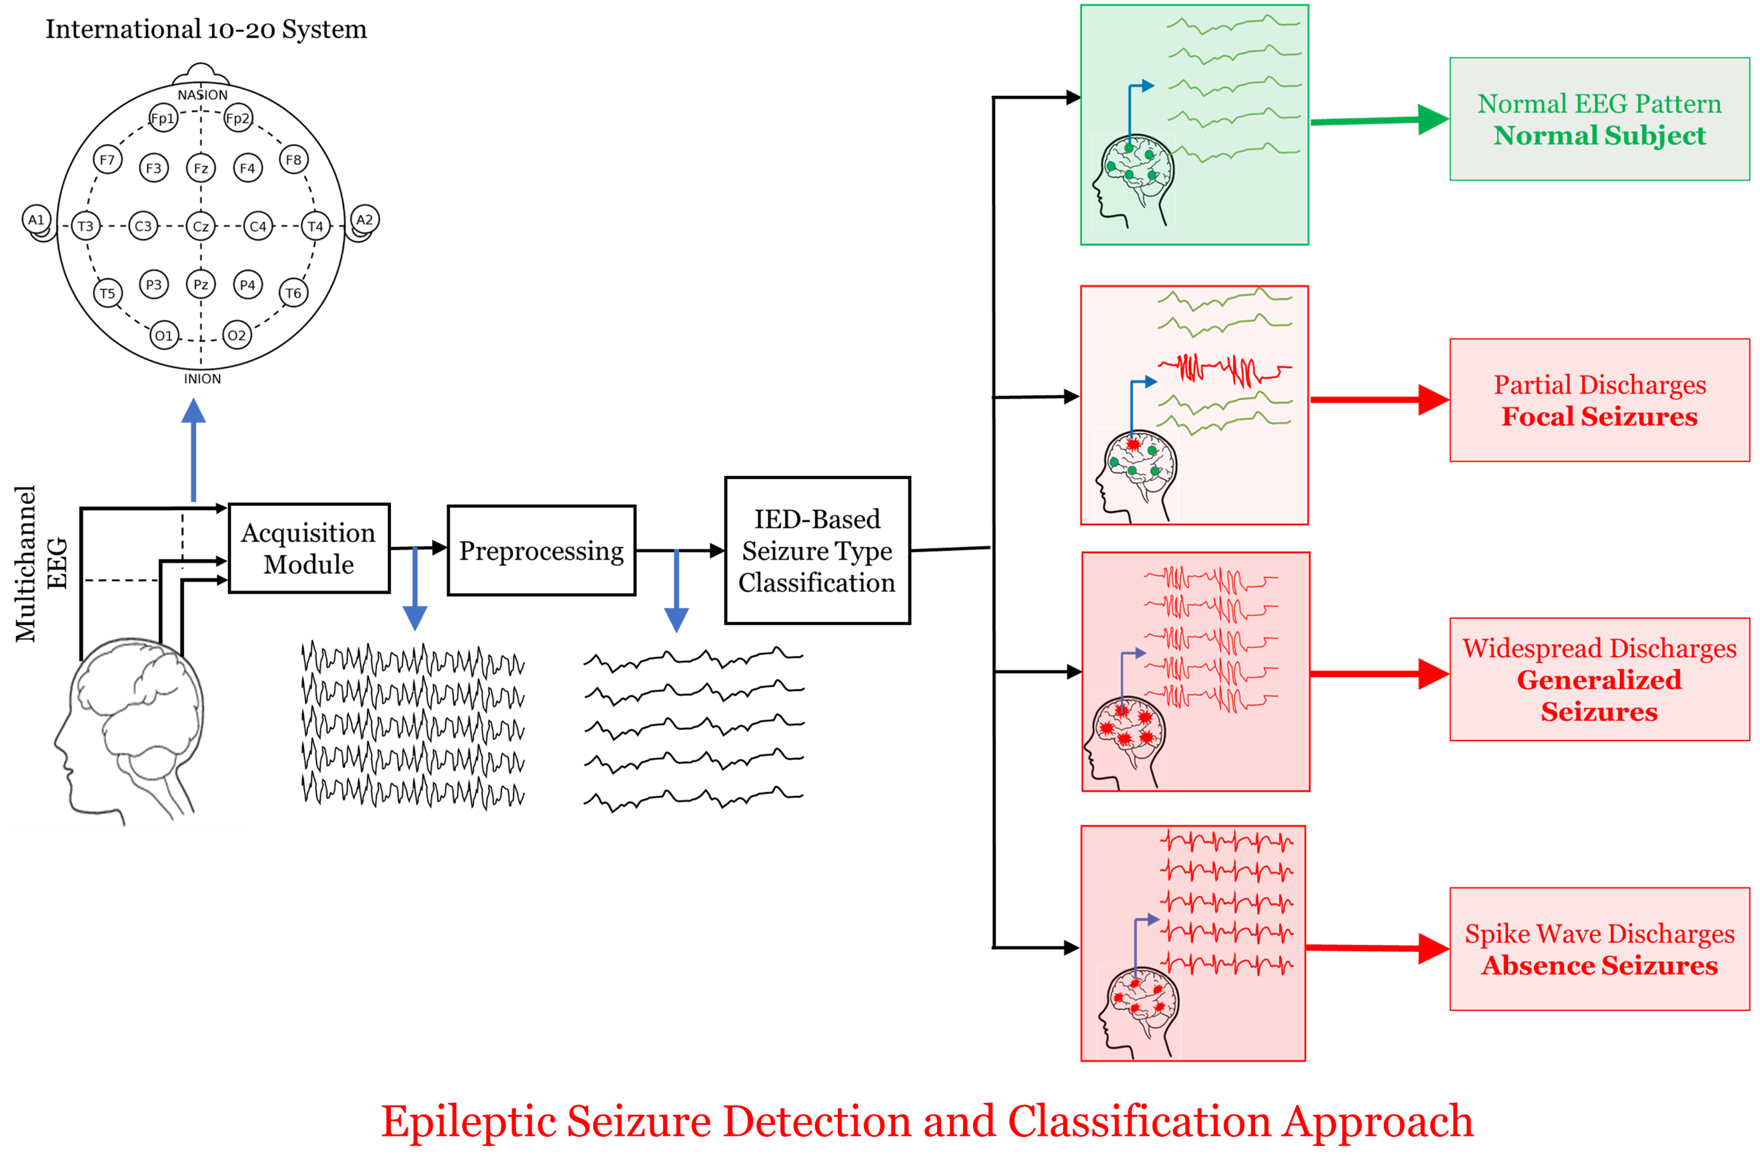

Slide 3
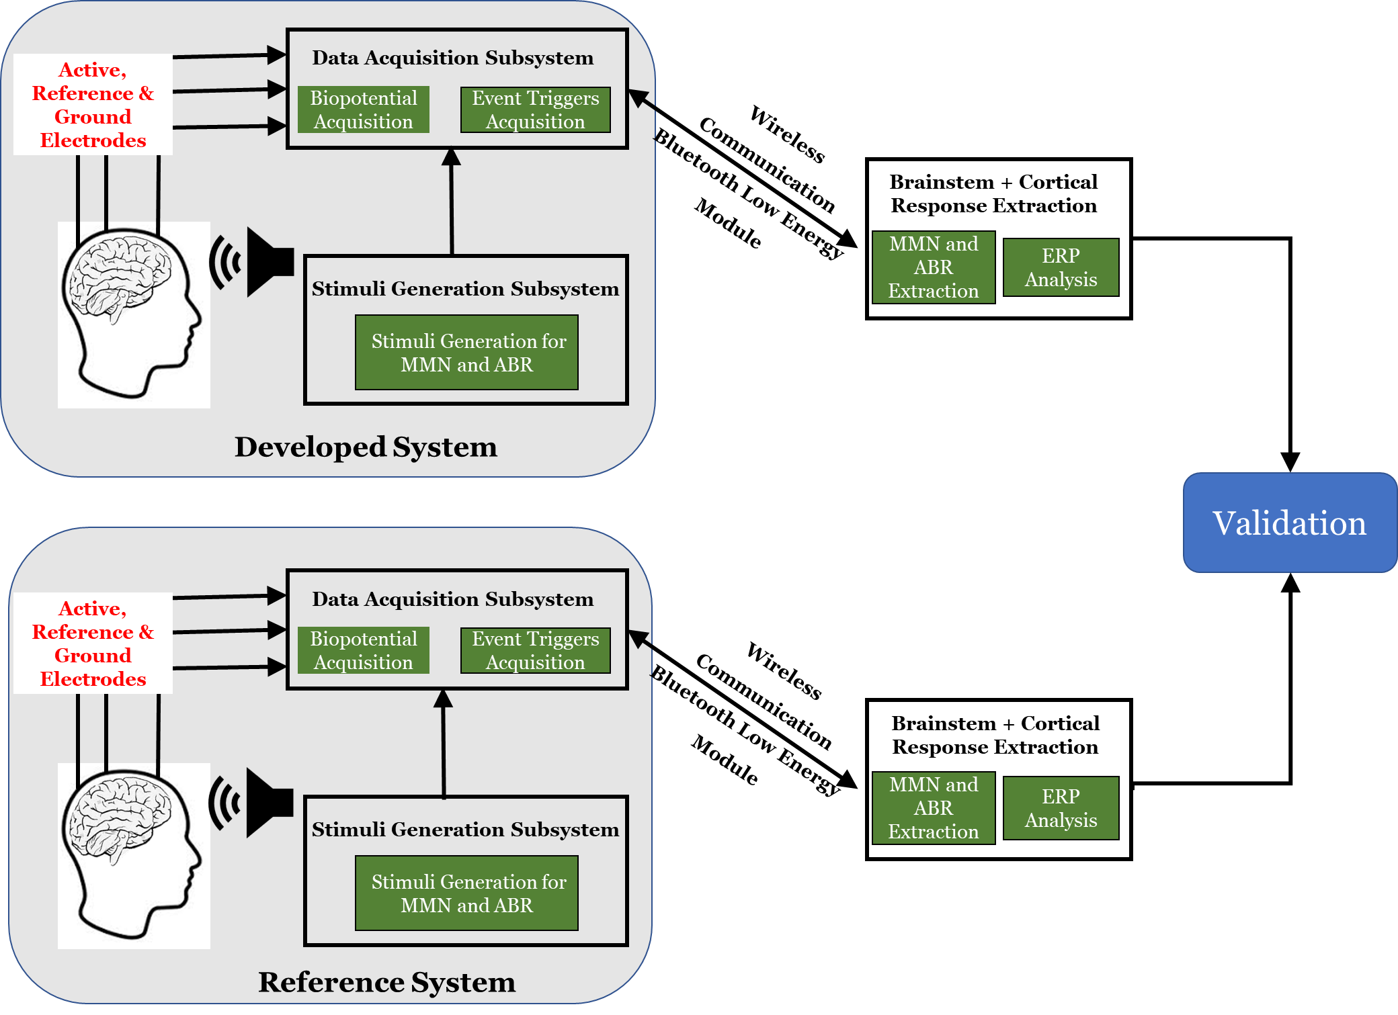


Slide 4
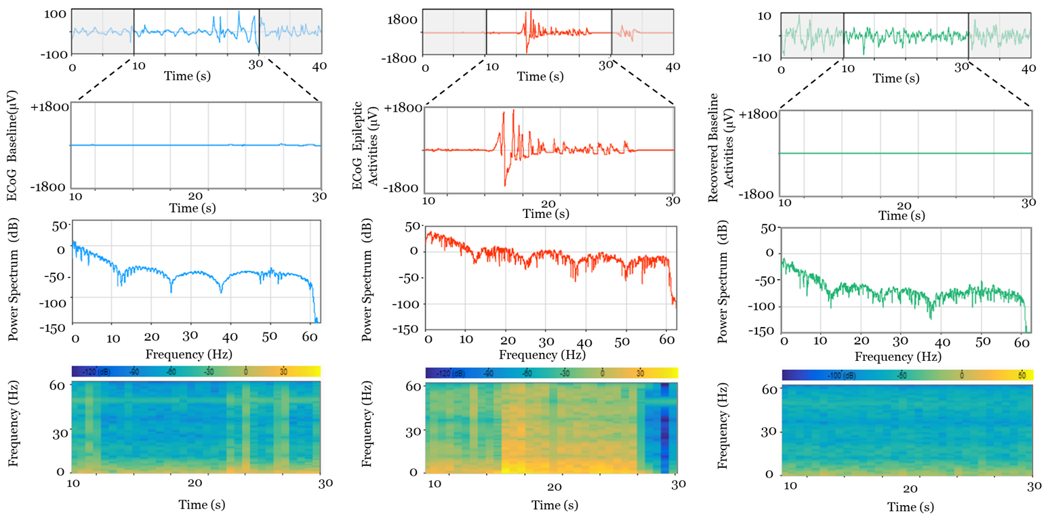
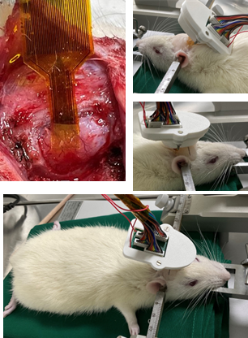
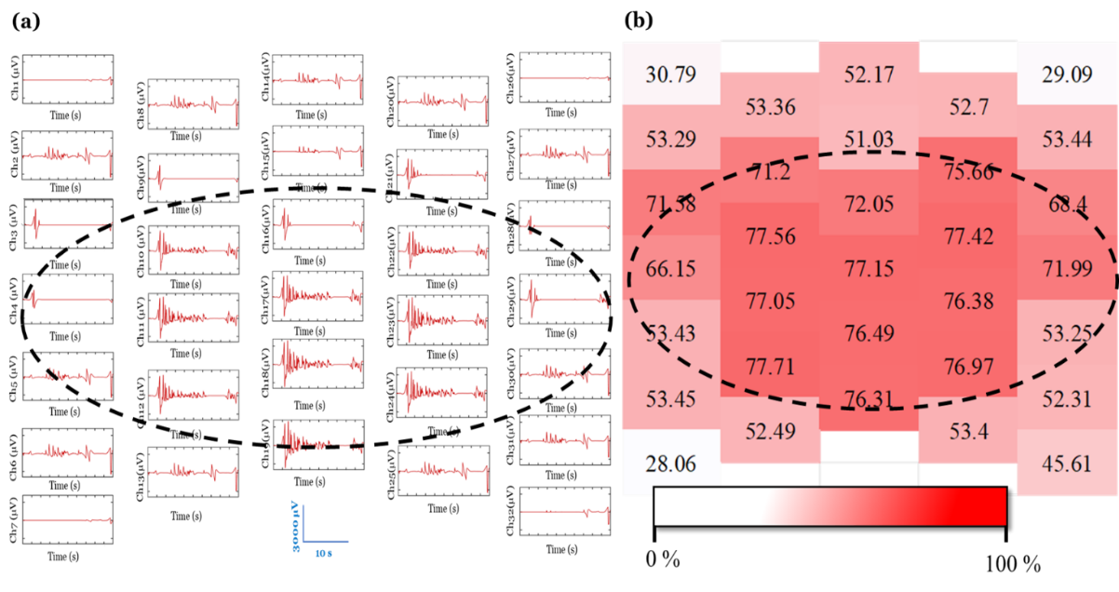
Time-Frequency Analysis of Acquired ECoG
in-vivo Experiments
Spatial Analysis of Epileptic Activities

Slide 5
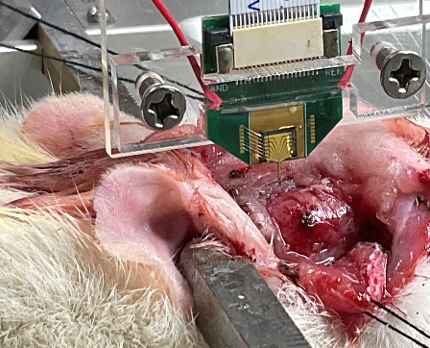
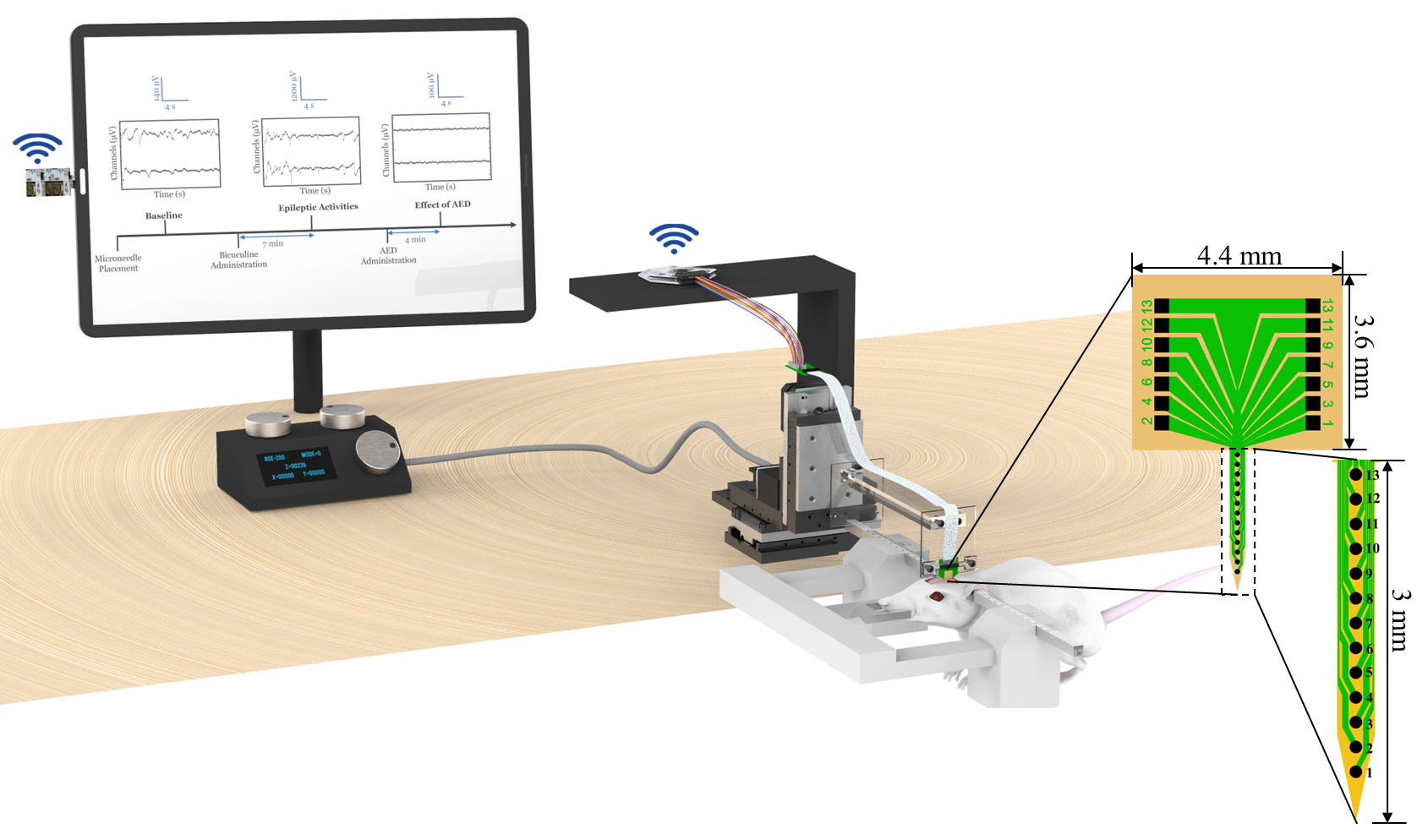
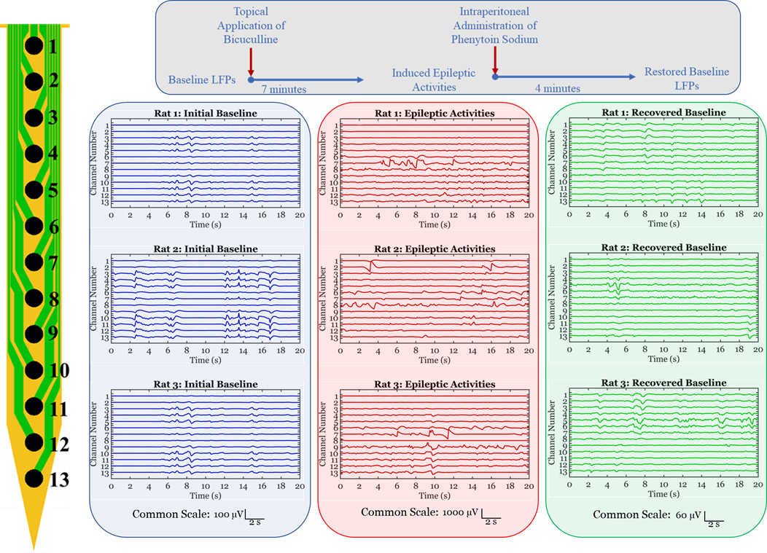
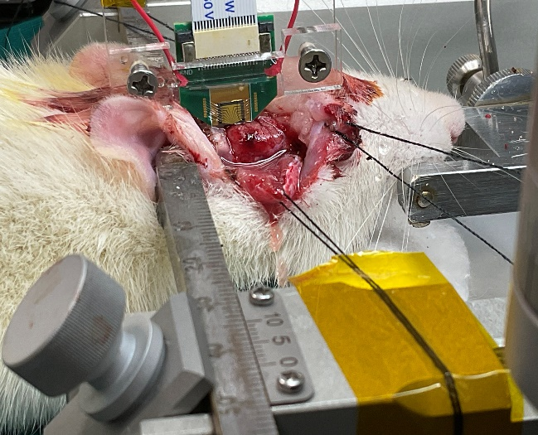
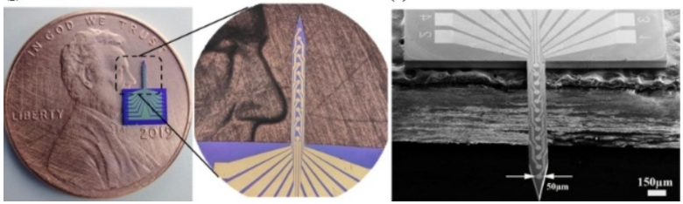
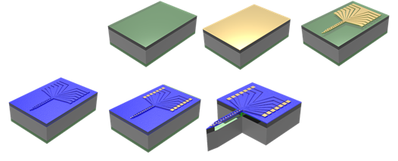
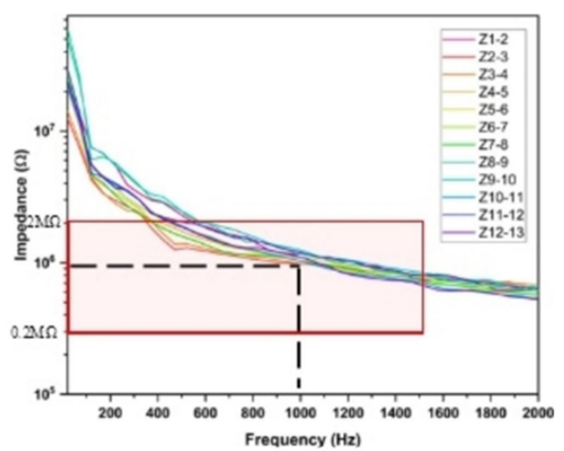

Schematic Illustration
Implantation
Acquired Temporal Traces
Temporal Traces
Cyton Daisy Acquisition Board
Dongle
Receiver
Micromanipulator
Controller
Micromanipulator
Rodent Adapter
Microneedle Fabrication Characterization
Ti/Au
Oxide deposited by PECVD
Si Wafer
Thermally Grown Oxide

Slide 6
